Slide 1
STORY TELLING METHOD
SHIRIM Learning Session 3
Arnob Chakrabarty RedOrange Media & Communications

Slide 2
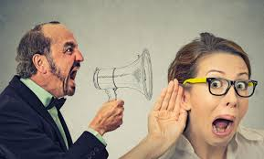
KNOWLEDGE SHARING
Do you understand me?
seven tips from
storytelling method

Slide 3
Count the number of ‘F’ in the following text
FINISHED FILES ARE THE RESULT OF YEARS OF SCIENTIFIC STUDY COMBINED WITH THE EXPERIENCE OF YEARS

Slide 4
FINISHED FILES ARE THE RESULT OF YEARS OF SCIENTIFIC STUDY COMBINED WITH THE EXPERIENCE OF YEARS
Count the number of ‘F’ in the following text

Slide 5
The combination of elements of a message determines interpretation of the message

Slide 6
The combination of elements of an image determines Interpretation of the images
The whole is greater than the sum of all it's parts

Slide 8
Iwo Jima Memorial Washington
Ground Zero New York

Slide 9
COMMUNICATION
sender
CODE
receiver

Slide 10
Start small then big
No opinion but experience
Avoid adjectives, describe facts
No issues/problems but people
After figures, use comparison
Mind your language
You can never tell two stories at a time
How do I communicate?
seven tips from
story telling method

Slide 11
THANK YOU FOR WATCHING
Mauritskade 63
1092 AD Amsterdam
The Netherlands
P.O. Box 95001
1090 HA Amsterdam
T : +31 (0) 20 56 88 701
E: info@share-netinternational.org
E: info@share-net.nl

